Slide 1
There is three main Algae classification:
Chlorophyceae – These are called green algae, due to the presence of pigments chlorophyll a and b. Examples are Chlamydomonas, Spirogyra, and Chara
Phaeophyceae – Also called as brown algae, they are predominantly marine. They have chlorophyll a, c, carotenoids and xanthophyll pigments. Examples are Dictyota, Laminaria, and Sargassum
Rhodophyceae – They are the red algae because of the presence of the red pigment, r-phycoerythrin. Examples are Porphyra, Gracilaria, and Gelidium.
Diatomata - chlorophyll a and c, carotenoids
Blue – Green algae - chlorophyll a , Фикоцианин

Slide 2
Chlorophyta
Chlorophyta is a division of green algae contain chlorophylls a and b, and store food as starch in their plastids. There are many different species belonging to Chlorophyta; some are unicellular, some are multicelluar. The genome structures within Chlorophyta are all different. However, there are some common characteristics across species. Chlorophyta inhabit freshwater, marine and terrestrial habitats. Conditions for survival include light, carbon, essential nutrients, water quality, temperature and tidal exposure. Certain intertidal species such as the ulva, or sea lettuce, can tolerate a range of temperatures and survive drying at low tide. While most chlorophyta are aquatic.

Slide 4
1- General characteristics
1-Tend to grow well in summer, with ample light and nutrients and high temperature
2-Some filamentous forms may be inedible
3-Flagella may reduce tendency to sink
4-Many shapes and sizes but planktonic Chlorophyta tend to share a
characteristic: rapid growth potential

Slide 5
2-Cell Structure and Metabolism
Most Chlorophyta are unicelluar, but there are some multicelluar species.
Some are free-living, some are colonial, others are coenocytic. Filamentous sporophytes have singluar lenticular nuclei, which are embedded in a thick cytoplasm.
Chlorophyta usually have biflagellated gametes. Like other green plants, Chlorophyta contain chlorophylls a and b, although the major pigment is chlorophyll b.
In addition, some tropical species are pigmented by siphonoxanthin and siphonein. They store starches made from photosynthesis in double-membrane bounded chloroplasts. Cell walls are made of cellulose.

Slide 6
Parenchymatous
Siphonocladous
Fig.1: General Forms of Chlorophyta

Slide 7
Chlorophyta are photosynthetic organisms, obtaining starch from photosynthesis. They are autotrophic.
Fig.2: General structure of Chlorophyta

Slide 8
3- Reproduction and Life cycle
Chlorophyta reproduce both sexually and asexually, but usually sexually. Asexual reproduction can occurs by fission, fragmentation, or zoospores. Sexual reproduction can be isogamous, anisogamous, or oogamous. The species Ulva lobata experiences alternation of generations, alternating between haploid and diploid phases. In the haploid phase, gametes are formed; in the diploid phase, zoospores are formed. Not all species have this, however. For the species without alternation, meiosis occurs in the zygote.
Chlorophyta can exist as single cells, multi-cellular filaments or colonies. As single cells, green algae may be motile or moving, or nonmotile. An example of this unicellular organism is the fast growing chlorella that live inside animals.
Multi-cellular filaments can involve a life cycle that includes both sexual and asexual reproduction. The ulva, for example, goes through the process of alternation of generations or alternate forms of reproduction. Parents’ characteristics are recombined through the fusion of gametes, but reproduction also occurs through spores.
Colonies may consist of loose aggregates of single cells or an arrangement of cells in a pattern. These cells lack specialized functions. Reproduction occurs more rapidly with nearby mating cells. An example of a colony is the volvox, which has strands of cytoplasm-bonding individual cells. Hundreds of thousands of bright green cells form a sphere-shaped colony that uses its flagella to spin in the water.

Slide 9
Fig. 3: General Life cycle of Chlorophyta

Slide 10
3-1 Oedogonium Life Cycle
Asexual Reproduction Oedogonium is a form of filamentous green algae. It is capabable of reproducing asexually, which means that each oedogonium has both male and female reproductive organs. In asexual reproduction, the oedogonium fragments and produces zoospores. Zoospores are able to move spontaneously through the water. Once the zoospore is produced, it is released and is free to find a viable substrate. Once found, the zoospore's cells are able to divide and form a new filament of oedogonium.
Sexual Reproduction: Zygote Production
In addition to being able to reproduce asexually, the oedogonium is capable of reproducing sexually. In sexual reproduction, the filament portion of the oedogonium, called the antheridium, produces and releases sperm. The sperm sinks through the water until it meets with the filament portion of the oedogonium, called the oogonium, which contains a large egg. If the sperm successfully fertilizes the egg, a zygote is produced.
Sexual Reproduction: Zoospores
After the zygote is produced, it is released into the water and develops zoospores. The zoospores are similar to those created through asexual reproduction. Once the zoospores mature, the zygote splits open, releasing the zoospores. The zoospores then attach to the bottom of the sea and the cells in the zoospores divide to produce a new filament of oedogonium.

Slide 11
Fig.4: Life cycle of Oedogonium

Slide 12
4- Ecology
Cholorophyta are adapted to shallow water, and live in both freshwater and marine habitats. 90% of Chlorophyta are freshwater species. Those that live in marine habitats largely inhabit tropical environments. There are a small number of terrestrial species; these largely dwell on rocks or trees. Some species form symbiotic relationships with fungi, producing lichens. There are a few instances in which Chlorophyta have formed symbiotic relationships with animals.
The Chlorophyta species Caulerpa racemosa was introduced to the Mediterranean Sea in 1990. It was first observed in France in 1997, and has continued spreading. Many of the invaded locations are fishing areas. The Mediterranean Sea has many environmental factors that encourage the growth of Caulerpa racemosa, such as an ideal climate and substrata.
The species Spirogyra insignis is known to adapt to harsh conditions through spontaneous mutation. Flores-Moya et. al. (2005) studied the adaptation of this species in sulpherous waters. At first, its growth and reproduction was inhibited. However, the culture survived due to thegrowth of a resistant variant that formed before the culture was introduced to these sulfurous waters. This type of spontaneous mutation is what allows the species to survive.

Slide 13
5- Class Chlorophyceae
This group contains the largest number of species of the division. They can have two or more flagella, near the apex of the cell. Mitosis in this class involves phycoplasts, microtubules that develop between and separate the daughter nuclei. This characteristic is not seen in any other organism, implying that no organisms have descended from this class. There are a variety of asexual and sexual reproductive techniques. Sexual reproduction is characterized by the formation of a zygospore (a dormant diploid zygote protected by a thick wall) that later undergoes meiosis.
The class includes unicellular organisms such as those in the genus Chlamydomonas with their two apical flagella and nonmotile organisms such as Chlorella, which is being cultivated for use as a dietary supplement. Colonial genera of Chlorophyceae include Hydrodictyon (the "water net") and the so-called volvocine line of flagellated specimens that range from simple colonies of Gonium to the intricate spinning spheres of Volvox, which can consist of up to 60,000 cells and exhibit some cellular specialization. The most complex of the class are the filamentous members.

Slide 14
6- Class Ulvophyceae
Ulvophyceae contains marine organisms that take a variety of shapes that may consist of a few cells, long filaments, thin sheets of cells, or coenocytic cells. Most approach being radially symmetrical. They have an alternation of generations and unlike in the other classes, meiosis occurs in the spores rather than the zygotes. When present, there can be two or more apical flagella. During mitosis, the nuclear envelope and the mitotic spindle persist, as they do in the Charophyceae.
7- Class Charophyceae
Charophyceae are of great fossil age; the stoneworts date as far back as the late Silurian period. Cells of this class are asymetrical. Those that are motile have two flagella, at right angles near the apex of the cell. Sexual reproduction in this class, as in Chlorophyceae, is characterized by the formation of a zygospore and zygotic meiosis. Unlike in the other two common classes of green algae, but as with plants, the nuclear envelope disintegrates when mitosis begins. During cell division the mitotic spindle is present; in some a phragmoplast similar to those seen in plants aids in the formation of a cell plate. Plants are thought to have evolved from early species of Charophyceae.

Slide 15
The class includes Spirogyra, familiar filamentous algae that float on ponds and lakes in slimy masses. The desmids are single cells noted for their extraordinary symmetry and geometrical beauty. They are found only in fresh (usually still) water and often take an important place in the food chains of small nutrient-poor ponds and peat bogs. The stoneworts consist of a complex branched thallus with an erect stemlike structure and many whorls of short branches.

Slide 16
Phaeophyceae - Brown Algae
The Phaeophyta or brown algae are mostly marine algae. Phaeophyta are characterized by the pigment fucoxanthin that gives them the brown colour. The cell wall in Phaeophyta is two layered; inner layer consists of cellulose and outer layer mainly of algin and fucoidan. The brown seaweeds serve as important source of the industrial hydrocolloid alginate as well as food in countries like Japan, Korea and China.
General characteristics
(a) Occurrence: Mostly marine.
(b) Pigments: Fucoxanthin is dominant, Chlorophyll a, c and carotene.
(c) Pyrenoids: Stalked pyrenoids present outside the chloroplast envelope..
(d) Reserve food material: Laminarin, mannitol and fats.
(e) Cell wall: Cellulose, alginic acid and fucinic acid.
(f) Structure: Microscopic to branched, filamentous macroscopic parenchymatous plants.
(g) Flagella: Zoospores flagellated, flagella unequal, one is tinsel type.
(h) Reproduction: Sexual reproduction (isogamous, anisogamous and oogamous).

Slide 17
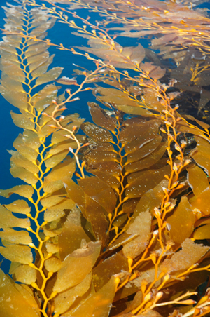
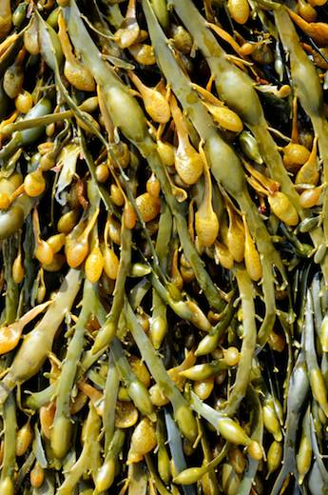
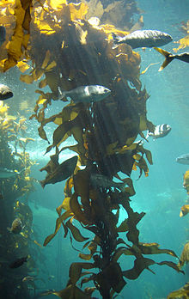
Structure
Most of brown algae are lithophytes , which require stable hard substrata for attachment, and a number of the fi lamentous, smaller species are epiphytes. Unicellular, colonolial and unbranched fi laments are absent inpheophyceae. The freshwater phaeophyta species are simply filamentous and smaller in size unlike their marine counterparts which have complex gigantic and bulky thalli Their size ranging from small fi lamentous forms like Ectocarpus and Hinskia , which are few millimetres to massive intertidal weeds such as Ascophyllum and Fucus , to subtidal large kelps and the largest seaweed known Macrocystis pyrifera, They have higher morphological and anatomical differentiation compared to the other algae The size range vary greatly, from crustose form which may be 1–2 mm, macroscopic fi lmentous tufts 2–10 mm, subtidal kelp forests that might be as tall as 20–60 m.
Fig. General Morphology of Brown Algae

Slide 18
The cell walls of brown algae are generally gelatinous and consist of two layers. Cellulose makes up the skeleton backbone but is present in small quantiites i.e. 1–8 % of dry weight. The chloroplasts of brown algae are usually discoid and surrounded by an envelope. The outer membranes of the chloroplast endoplasmic reticulum are continuous or discontinuous depending on the species. Microfibrils of DNA occurring in the plastid may be linear or circular attached to the thylakoid membranes. The pigments are located in plastids lacking pyrenoid; their presence may also vary according to algal stage.
Presence of Physodes (fucosan granules) is one of the characteristic features of brown algae. In the meristmatic, photosynthetic and reproductive cells, cytoplasm a large number of colourless vesicles with highly refractive acidic fl uid staining red with vanillin and hydrochloric acid are present.
Reproduction
Brown alga reproduces by vegetative, asexual and sexual methods of reproduction:
1- Vegetative Reproduction
Several species of brown algae show vegetative reproduction via fragmentation. In members of sphaecelariales propagules are found
2-Asexual Reproduction
All brown algae reproduce asexually with exceptions of Tilopetridales, Dictyotales and Fucales. In ectocarpales and spherocarpales asexual reproduction occurs via biflagellate zoospores that develops in to reproductive organs called sporangia which could be unilocular (onecelled) or many cells plurilocular as observed in Hinski amitchelliae. Gametes can also reproduce parthenogenetically to form asexual progenies, for example in Ectocarpus . Asexual reproduction is
absent in Laminaria

Slide 19
3-Sexual Reproduction
In pheophyceae sexual reproduction takes place by the formation of flagellate gametes that are formed inside gametangia. Multicellular gametangia are formed only in some of the brown algae , The haploid thalli form ranges from isogamous (both male and female gametes exactly similar), anisogamous (female gamete larger than male) to oogamous (small fl agellated male and large non-fl agellated female gametes), The sexual reproduction is through fusion of flagellated male and female gametes or fusion of flagellated male and large non-flagellated female gametes. The haploid (gametangial) and diploid (sporangial) thalli may be similar (isomorphic) as in Ectocarpales or different (heteromorphic) in appearance for example in Laminariales, or the gametangial generation may be extremely reduced (Fucales).
3-Life Cycle
Brown algal life cycle shows alteration of generations of haploid and diploid organisms:
1-Haploid gametophytes (n) give rise to haploid gametes by mitosis.
2-male and female gametes (n) fusion give rise to zygote (2n) that forms diploid sporophyte
3-The sporophyte (2n) produces meiospores (n) by meiosis which germinates and
4-forms haploid gametophyte.
5-Brown algae life cycle may be isomorphic, heteromorphic and Diplontic.

Slide 20
3-1 Life Cycle of Ectocarpus
The sexual life cycle of Ectocarpus consists of alternating heteromorphic gametophyte and sporophyte generations. Both generations of the sexual life cycle are multicellular. The sexual life cycle in the sporophyte generation starts with the formation of a diploid zygote that undergoes a bipolar germination to produce two germs tubes that eventually forms the sporophyte. The initial cell division in the zygote is symmetric. Two kindsof filaments prostrate and upright are produced in the sporophytic generation. Two specialized reproductive structures; plurilocular and unilocular sporangia are produced on the upright filaments.
A mitotic event in multi-chambered plurilocular sporangia releases mitospores, which after their release, forms sporophyte Unlike plurilocular sporangium, unilocular sporangium consists of single chamber that contain meiotically produced meiospores that give rise to multicellular gametophytes. Morphologically, it is hard to distinguish between a male and a female gametophyte. Like zygote, the meio-spores undergo a bipolar germination but the initial cell division of meio-spore is asymmetric that produces different cell types.
Only upright filaments have been observed in the gametophytic generation. Specialized reproductive structures called plurilocular gametangia are produced on the upright filaments of the gametophyte Plurilocular gametangia produce male and female gametes that are released in the surrounding marine water. Male and female gametes can be distinguished based on the behavior and physiology Unlike male gametes, female gametes settle quickly and release a sex pheromone that attracts male gametes. Once a male gamete fuses with a female gamete, a diploid zygote is produced that marks the onset of the first diploid structure of the sporophyte generation.

Slide 21
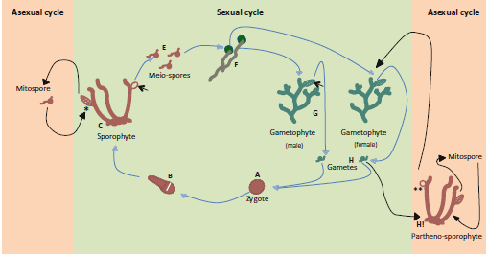
Fig.: General life cycle of Brown Algae (Ectocarpus)

Slide 22
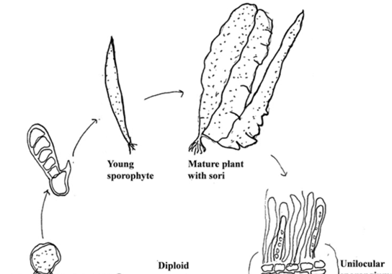
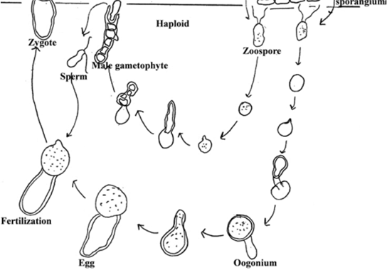
Fig.: Life cycle of Laminaria

